Slide 1

Adult group travel trends
Presentation By Data’ll be all Members: Michelle Ko, Katherine Mayo, Gargi Sapre, and Ilina Shah
Notes:
K -

Slide 2
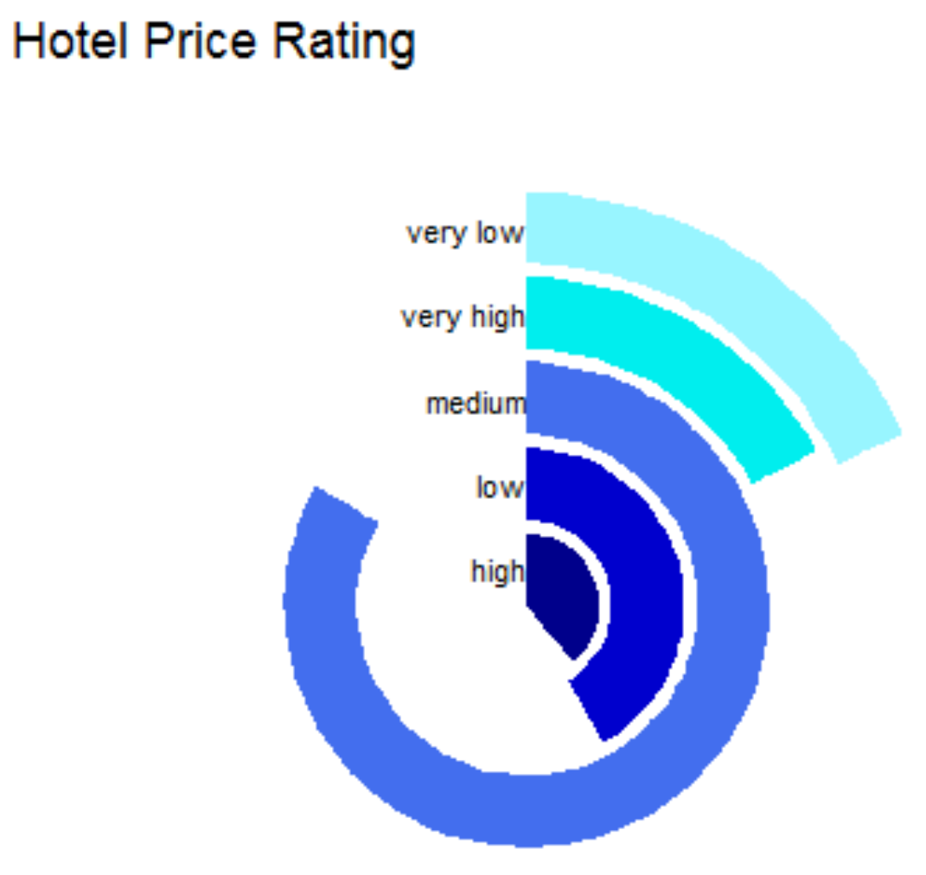
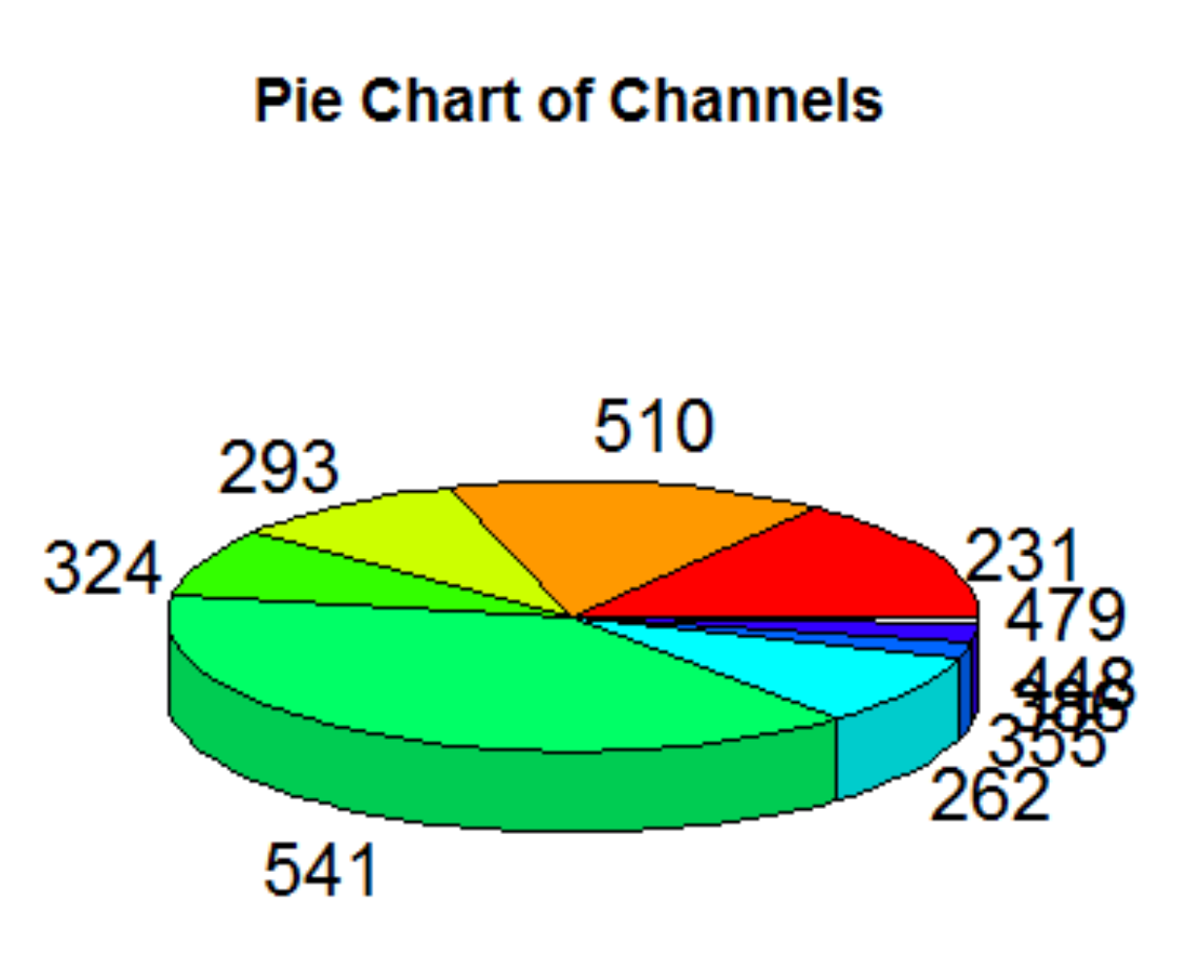
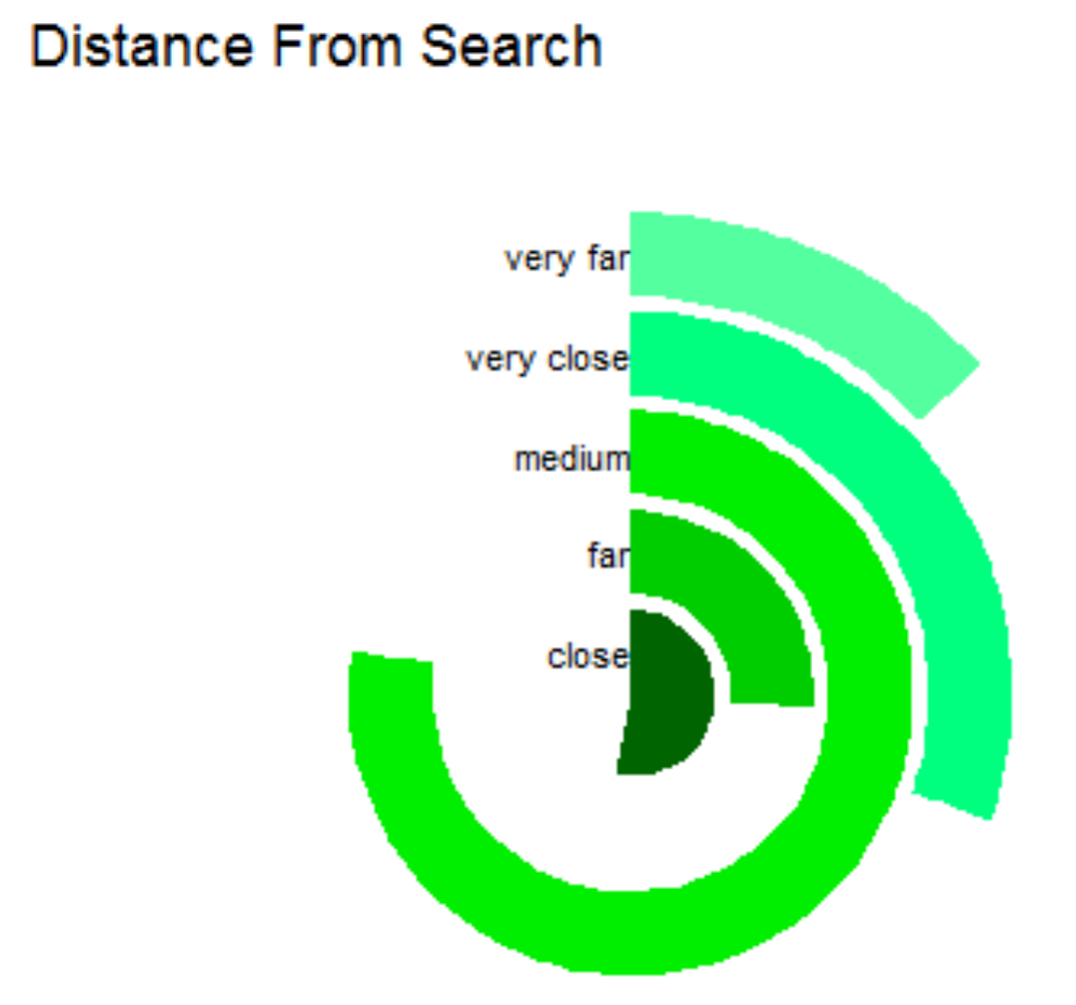



Notes:
K - 38%, price medium or low (would think adults might stay at nigcer places), close (adults might

Slide 3
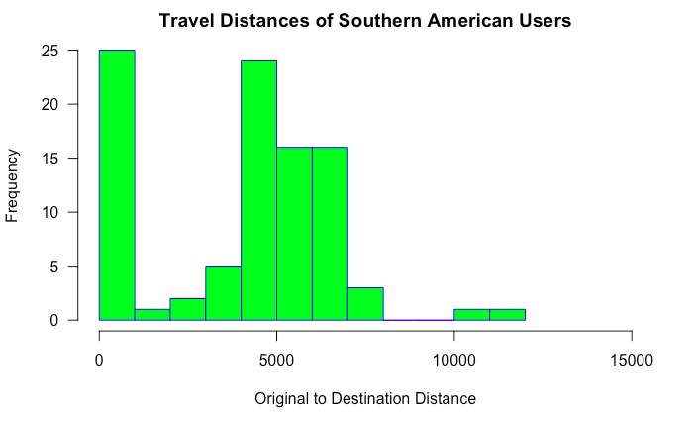
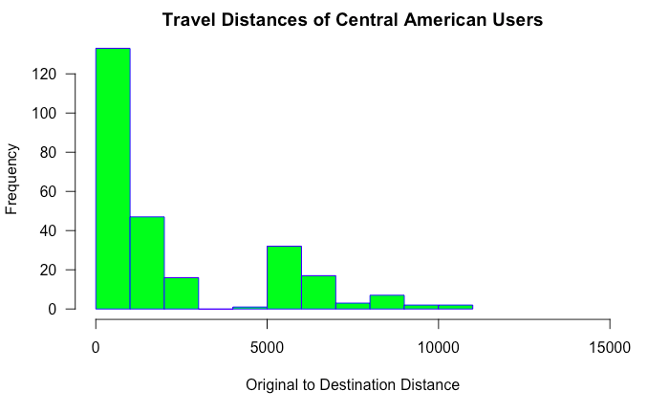
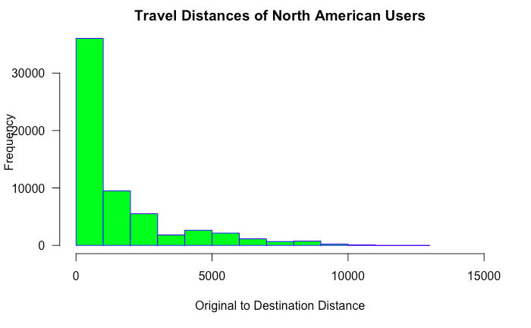
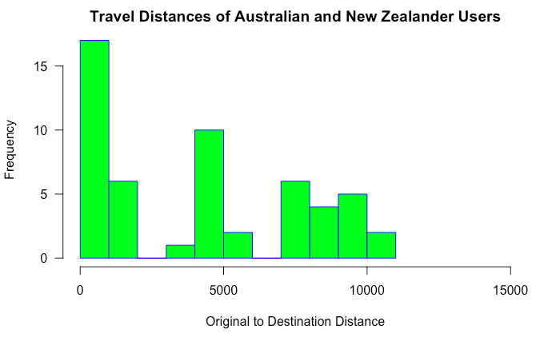
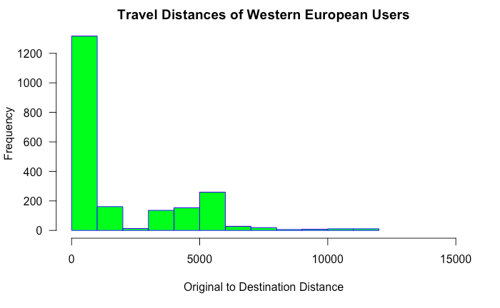

Slide 4




IN CONCLUSION

